Slide 1
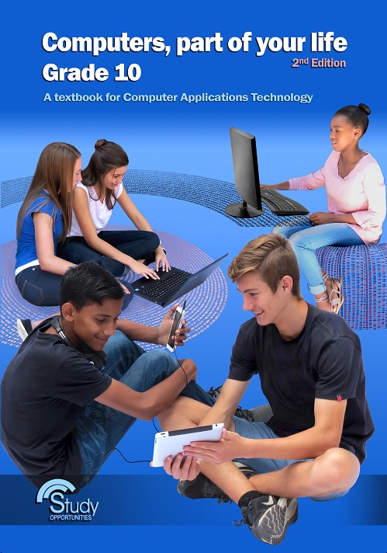
Module 1.1 Introduction to computers

Slide 2
Contents
What is a computer?
Hardware and software
The information processing cycle
Introduction to Windows
Start-up time
The desktop
Common features of programs
Saving our work
Introduction to the keyboard
The keyboard (input)
Keyboard skills
Test and improve

Slide 3
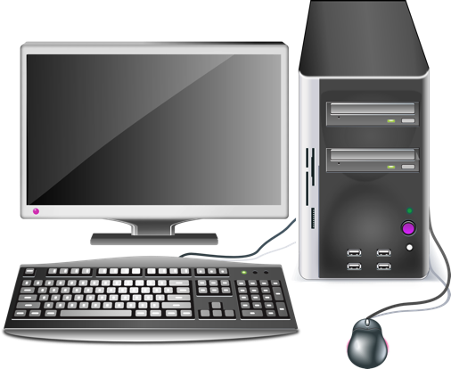
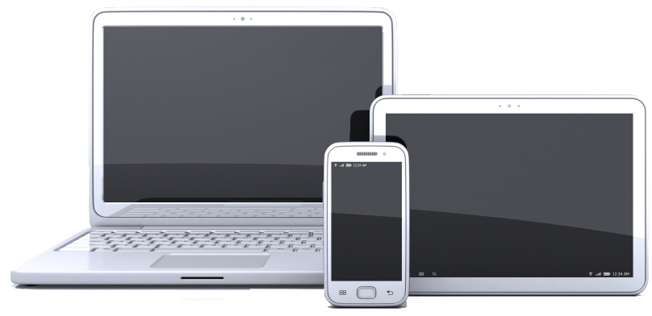
What is a computer?
Laptop
Smartphone
Tablet
Desktop
Multi-purpose
Electronic devices
Portable/mobile (left picture)

Slide 4
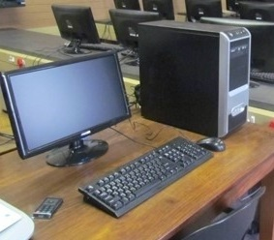
Hardware and software
Hardware
Physical parts of a computer that we can touch and see
Mouse, monitor, keyboard, printer
and the parts inside the computer box

Slide 5




Hardware and software
Software
Specific instructions we give the computer to get it to do something useful
Multi-purpose tool: ability to run different types of programs

Slide 6
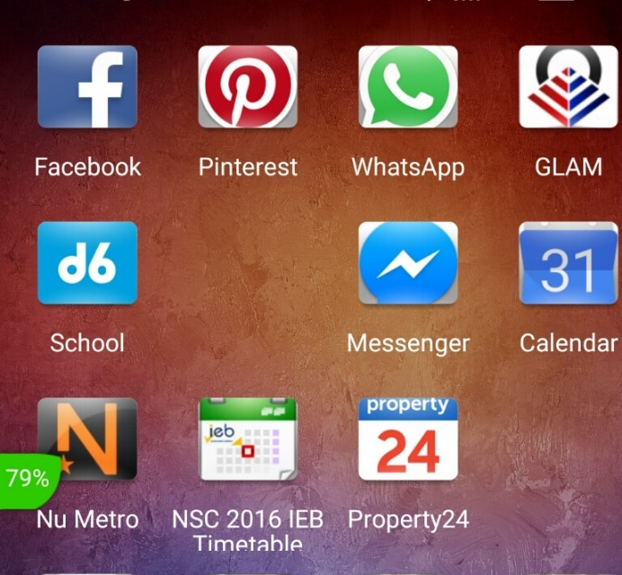
Hardware and software
Software
Why a smartphone can also be regarded as a ‘computer’
Apps enable it do much more than just make phone calls

Slide 7
The information processing cycle
Processing of data
Output
Input
Storage

Slide 8
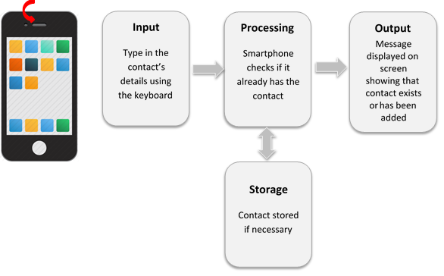
The information processing cycle
Example: adding a contact to your smartphone

Slide 9
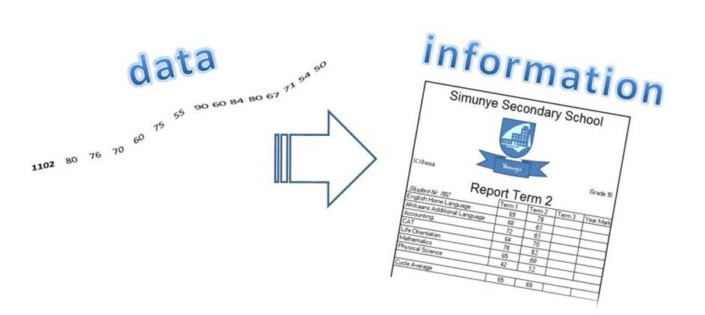
The information processing cycle
Computers process data into information

Slide 10
Activity 1

Slide 11
Introduction to Windows
Start-up time
Booting process: the operating system automatically loads when the computer is switched on
Log on with a username and password to get access to your own files and data

Slide 12
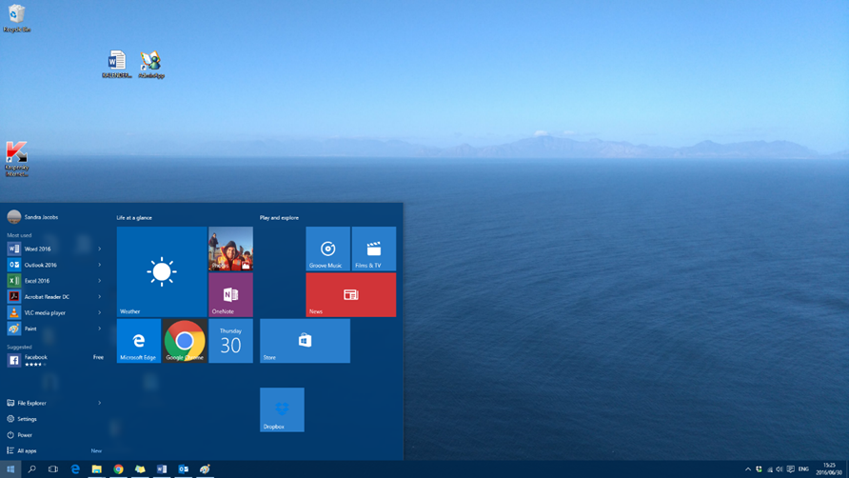
Introduction to Windows
The desktop
Icons
Desktop
Tiles
Start button
Notification area
Quick launch Taskbar

Slide 13

Introduction to Windows
GUI – Graphical User Interface
Common mouse actions:
Clicking
Double-clicking
Right-clicking
Dragging
Scrolling

Slide 14
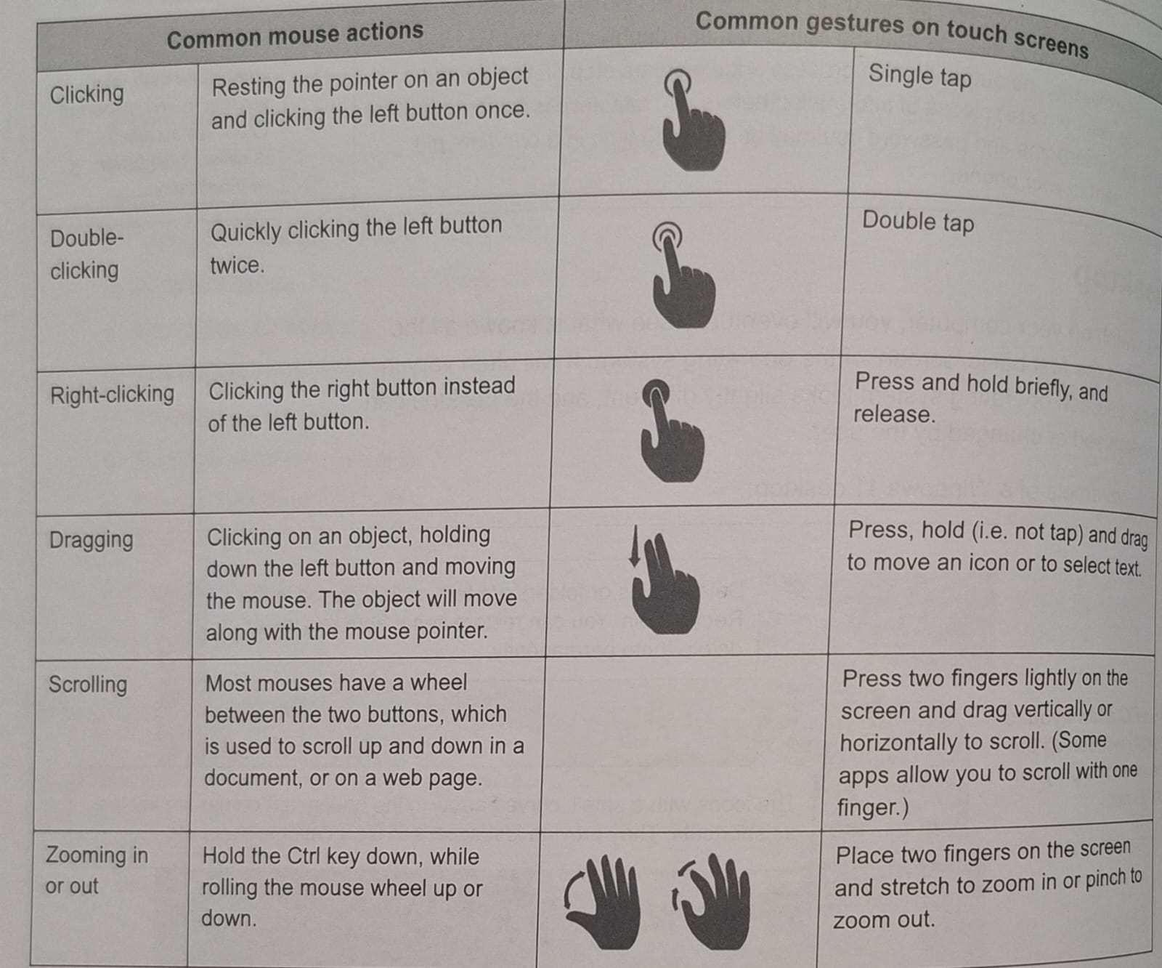
Actions of a Mouse

Slide 15
Activity 2

Slide 16
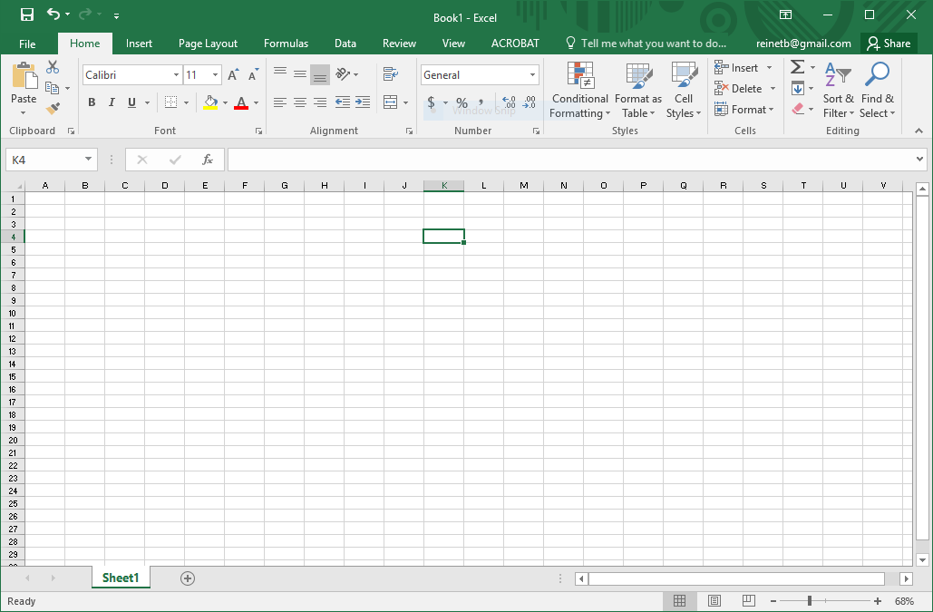
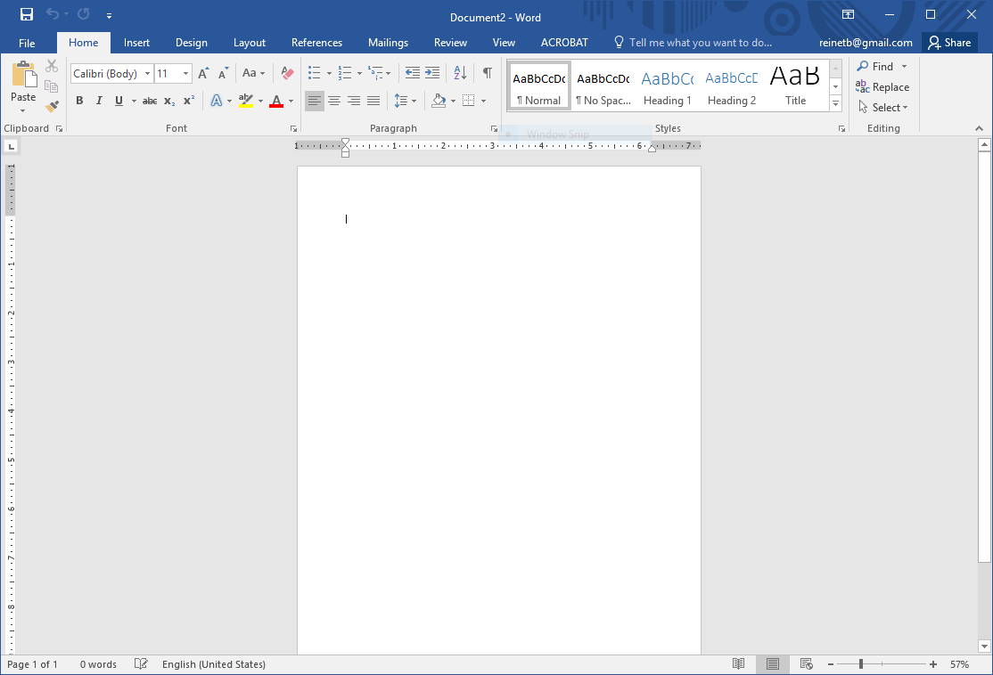
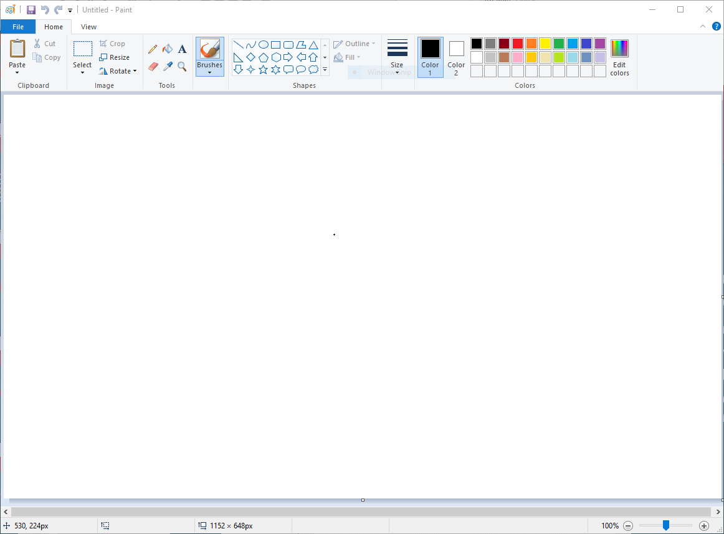
Introduction to Windows
Common features of programs
Title bar
Active window
Taskbar
Resizing or moving a window
Window control icons at top right

Slide 17
Activity 4

Slide 18
Activity 5

Slide 19
Saving our work
Current work done on a computer is kept temporarily in memory
To keep that work you have to save it to storage
Save work in files – organize files in folders
Give files and folders meaningful names

Slide 20
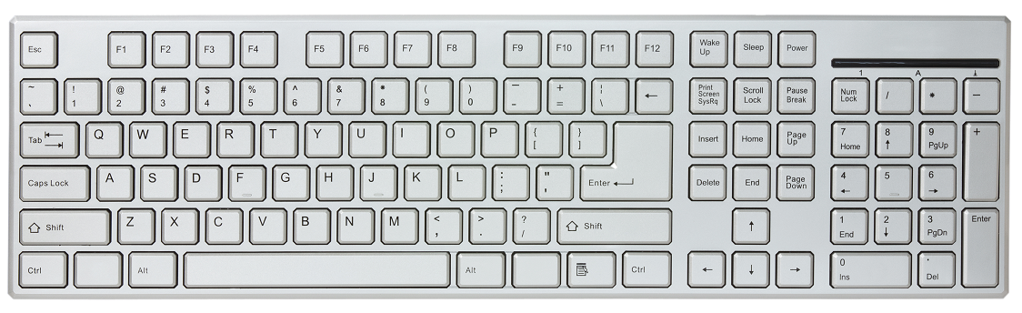
Introduction to the keyboard
Used to input data

Slide 21
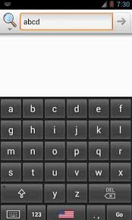
Introduction to the keyboard
Input on smartphone
Keyboard is displayed by software on screen – can display letters alphabetically rather than in qwerty layout

Slide 22
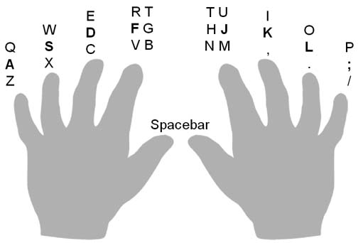
Introduction to the keyboard
Keyboard skills
Touch typing

Slide 23
Test and improve
Summary – concepts, terms and tips
What is a computer?
Introduction to Windows
Saving your work
Introduction to the keyboard

Slide 24
Written module activity

